Slide 1
A QA Transformation Story

Slide 2
History

Slide 3
Fall 2011

Slide 4
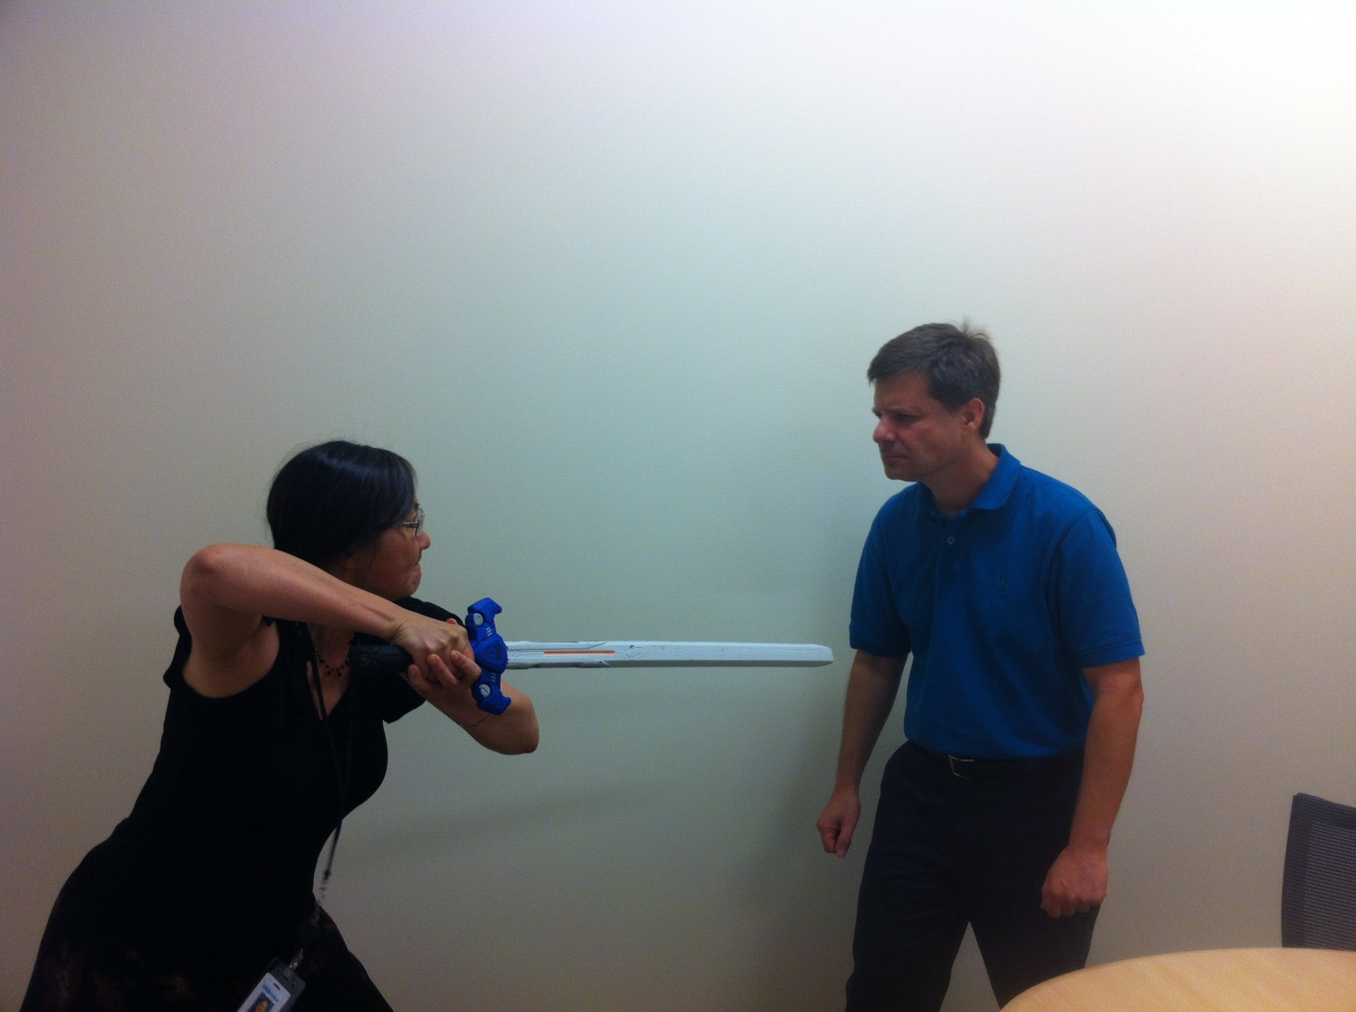
Is this your developer/tester relationship?

Slide 5
Fixing The Problem

Slide 6
The 3 Amigos
Notes:
Need to break down features enough so that you can discuss them at a granular level
Regardless of estimation method, this is a good time to right-size stories (estimating, re-estimating, or breaking down the story further)

Slide 7
Acceptance Criteria
Given I am a logged in user
When I go to the final checkout page
Then I should see the total cost of the order broken down by product cost, tax, and shipping charges
And I should see the total cost of the order

Slide 8
Feature: Process an order
Given I am a logged in user
When I go to the final checkout page
Then I should see the order broken down by product cost, tax, and shipping charges
And I should see the total cost of the order
Order total = total cost of products on the order + tax + shipping charges
Tax (only charged on the cost of the products, not the shipping):
Ohio = 7%
Michigan = 6.5%
Other states = 0%
Shipping:
If total cost of products (before tax >= $25), shipping is free, otherwise $5

Slide 9
Testing points
Notes:
What state it’s being shipped to (MI, OH, DC)
Try and ship to a non-US state
Cost + tax + shipping = total
Product cost < 25, = 25, > 25
Multiple products, one product

Slide 10
Feature: Process an order – Testing Notes
Products | Tax | Shipping
Order with one product | Ship to Ohio (7% tax) | Cost of product = $24.99 (shipping is $5)
Order with one product | Ship to Michigan (6.5% tax) | Cost of product = $25 (shipping is free)
Order with multiple products | Ship to DC, billing address is Ohio (0% tax) | Cost of products = $25.01 (shipping is free)
Verifications
Total cost = sum of cost of products + tax + shipping
Notes:
Combine all of the scenarios so that we can have fewer automated tests to write.

Slide 11
Feature: Process an order – Acceptance Criteria
Scenario: Order with one product, ship to OH, total product cost < $25
Given I am a logged in user
And the shopping cart is empty
And I add a product costing $24.99 to the cart
And my shipping state is OH
And my billing state is OH
When I go to the final checkout page
Then the tax amount should be $1.75
And the shipping amount should be $5.00
And the order total should be $31.74
Notes:
- This gherkin essentially becomes our requirements, our test plan, our method of verifying that our feature will meet the needs of the business, and potentially an automated acceptance test.
- The gherkin can be written by anyone on the team. The 3 amigos must all agree on the final gherkin.
- Bonus points if you can get people in the business to write requirements for you in this format!

Slide 12
3 Amigos Tips and Tricks
Break things into small chunks
Insist on acceptance criteria being complete before development begins
“3 Amigos” is not just a meeting
Remember the end goal – defined acceptance criteria and shared knowledge
Notes:
Once your team gets more disciplined, you can start leaving blanks in your acceptance criteria if they’re minor enough that they don’t prevent you from starting development. But initially I wouldn’t recommend that because people are still getting used to the rhythm of the new process
“3 Amigos” usually starts with a meeting, but then you can go off an work separately to define all of the details, and then come back together to agree on the final acceptance criteria
Do what makes sense for you! There are more than one way to achieve the end goal, so do what works best for your team.

Slide 13
Automated Acceptance Testing

Slide 14
File Builders

Slide 15
Restructuring Requirements
Notes:
- Requirements in the command pattern
- Software development is a series of transactions, and we want the translation steps to be as small as possible so that we don’t lose things in the translation. By having the requirements written in the same patterns as the code, it makes that translation step really small (and makes the development much easier).

Slide 16
A New Definition of Done

Slide 17
What happens when testing isn’t included in your definition of done
“Before”

Slide 18
What happens when testing IS included in your definition of done
“After”

Slide 19
Better Iteration Planning
Notes:
- Switched from 3 week iterations to 2 week iterations

Slide 20
Co-location

Slide 21
“The Pod”

Slide 22
Open workspace

Slide 23
GOAL Over Role

Slide 24
Where We’re At Now

Slide 25
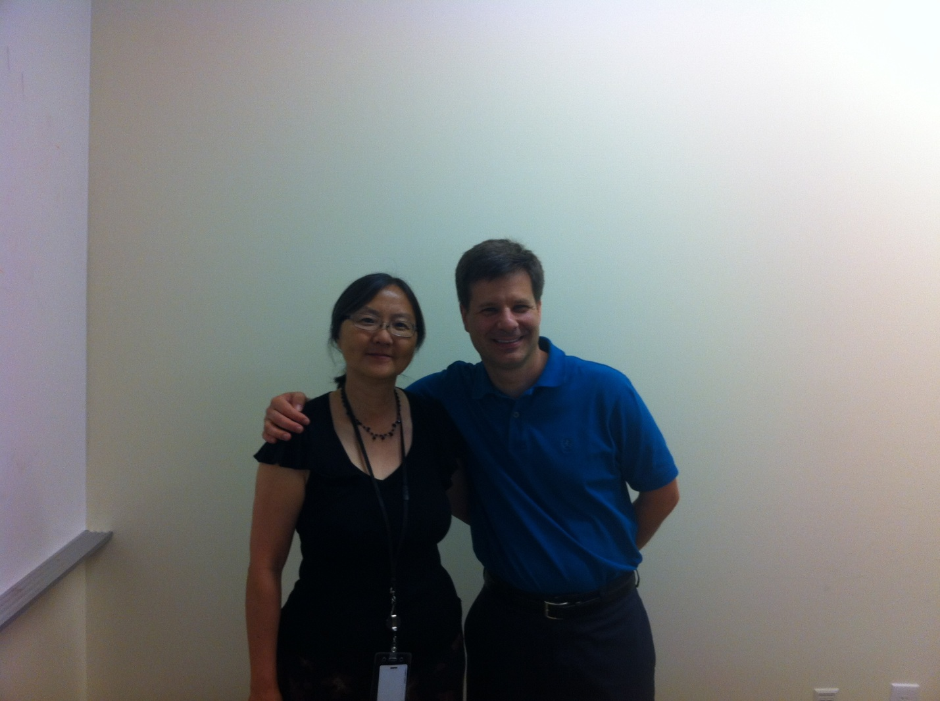
This is where our developer/tester relationship is now…

Slide 26
Manual vs. Automated Testing
Analysis – 1.5-2x vs. manual testing
Development – 2-2.5x vs. manual testing
QA – 1/8thx vs. manual testing
Churn – 1/8thx vs. manual testing
36% increase in productivity + Quality + Confidence – Technical Debt = ☺

Slide 27
“What’s It Gonna Cost Me”

Slide 28
We’re not there yet…
Continuous improvement across teams
Better involvement with business sponsors
More visibility of continuous integration build
75% of test cases automated in 2012

Slide 29
?

Slide 30
Thanks!
Brandon Childers
bchilders@igsenergy.com
@brandonchilders
Chris Hoover
choover@igsenergy.com
@AgileSixSigma
Lan Bloch
Lbloch@igsenergy.com
Laurel Odronic
Lodronic@igsenergy.com
@LOdronic
Jon Kruger
jon@jonkruger.com
@JonKruger
Slides
http://jonkruger.com/presentations/qa

